Slide 1


Java Fundamentals Decision Structures
CMPS 251
Read Chapters 2, 4 and 5
Unit 1_03

Slide 2
Outline
Relational Operators
if statement
Conditional Operator
switch statement

Slide 3

Java Decision Structures

Slide 4
Decision Making: Equality and Relational Operators
Condition :
An expression that can be true or false.
if selection statement :
Allows a program to make a decision based on a condition’s value.
Equality operators :
(== and !=)
Relational operators :
(>, <, >= and <=)

Slide 5
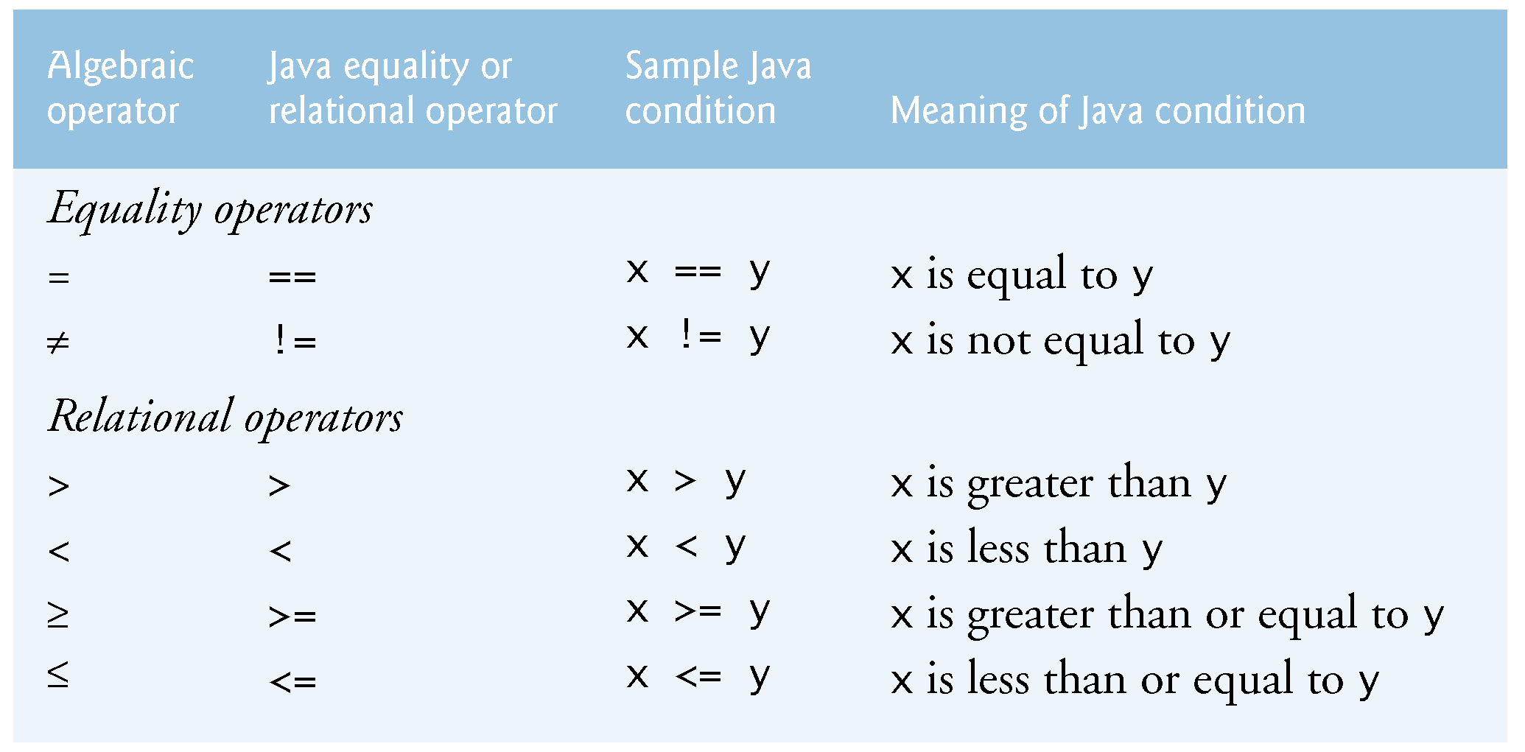
Decision Making: Equality and Relational Operators

Slide 6

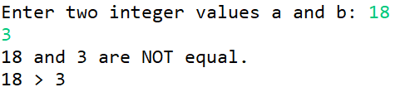

Decision Making: Equality and Relational Operators
Scanner input = new Scanner(System.in);
int a, b;
// prompt for input
System.out.print("Enter two integer values a and b: ");
a = input.nextInt(); // read first number
b = input.nextInt(); // read second number
if (a == b) {
System.out.printf("%d and %d are equal.%n", a, b);
}
if (a != b) {
System.out.printf("%d and %d are NOT equal. %n", a, b);
}
if (a > b) {
System.out.printf("%d > %d %n", a, b);
}

Slide 7
Selection Statements in Java
if statement:
Performs an action, if a condition is true; skips it, if false.
Single-selection statement—selects or ignores a single action (or group of actions).
if…else statement:
Performs an action if a condition is true and performs a different action (or groups of actions) if the condition is false.
switch statement
Performs one of several actions (or groups of actions), based on the value of an expression.

Slide 8
if Statement
Single option
if (boolean-expression) {
statement1;
...
statementN;
}
Two options
if (boolean-expression) {
...
} else {
...
}
Multiple options
if (boolean-expression) {
...
} else if (boolean-expression) {
...
} else if (boolean-expression) {
...
} else {
...
}
Notes:
The value inside the parenthesis must strictly be boolean

Slide 9
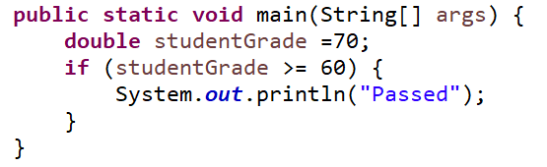
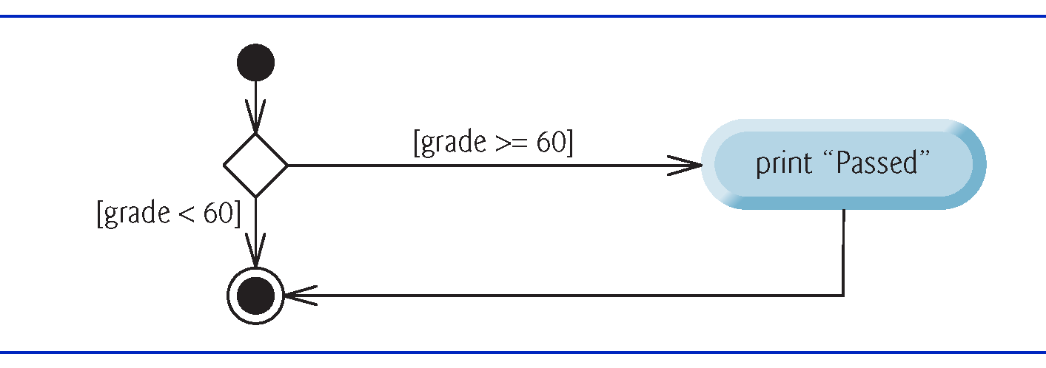
if Single-Selection Statement

Slide 10
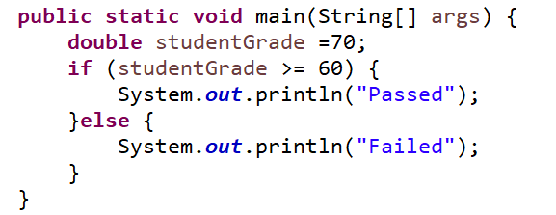
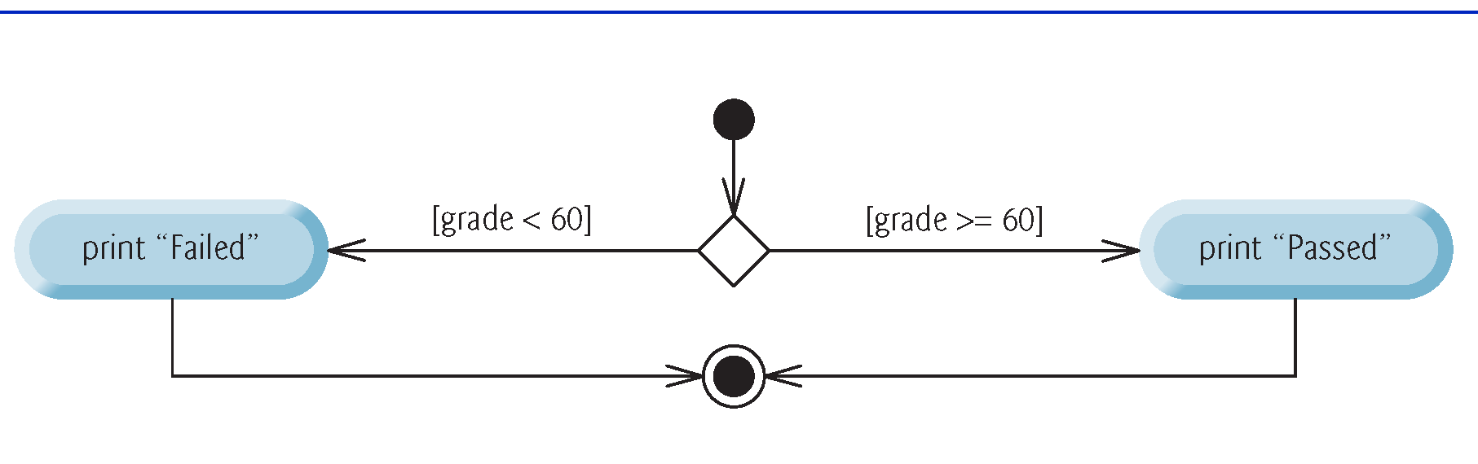
if…else Double-Selection Statement

Slide 11
Using if…else
import java.util.Scanner;
public class OddEven {
public static void main(String arg[])
{
Scanner input = new Scanner( System.in );
int x;
System.out.print( "Enter an integer: " );
x = input.nextInt();
if (x%2==0)
System.out.printf("%d %s",x,"is even number");
else
System.out.printf("%d %s",x,"is odd number");
}
}

Slide 12


Nested if…else Statements
Nested if…else Statements:
A program can test multiple cases by placing if…else statements inside other if…else statements to create nested if…else statements.
Scanner input = new Scanner(System.in);
System.out.print("Enter an ineger: ");
int i = input.nextInt();
if (i == 10)
{
// First if statement
if (i < 15)
{
System.out.println("i is smaller than 15");
// Nested - if statement
// Will only be executed if statement above it is true
if (i < 12)
System.out.println("i is smaller than 12 too");
}
else
System.out.println("i is greater than 15");
}
No output? Why?

Slide 13
Conditional operator
Conditional operator (?:) : shorthand if…else. Ternary operator (takes three operands)
Operands and ?: form a conditional expression
Operand to the left of the ? is a boolean expression—evaluates to a boolean value (true or false)
Second operand (between the ? and :) is the value if the boolean expression is true
Third operand (to the right of the :) is the value if the boolean expression evaluates to false.

Slide 14
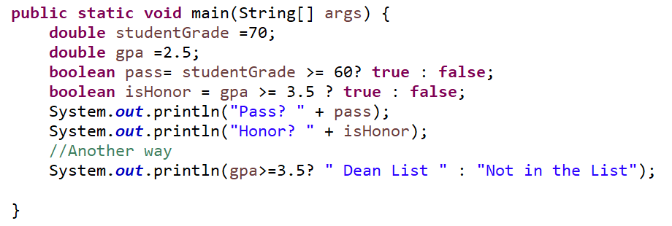

Conditional operator (cont.)

Slide 15
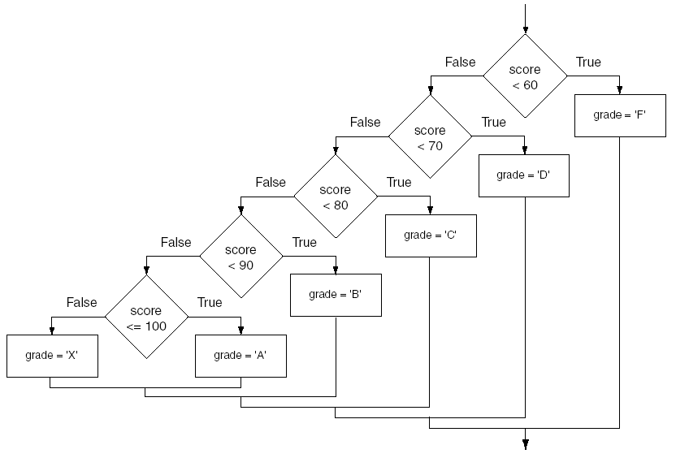
if…else ..if Statement
Nested if statements can become very complex.
The if-else-if statement makes certain types of nested decision logic simpler to write.
Care must be used since else statements match up with the immediately preceding unmatched if statement.

Slide 16
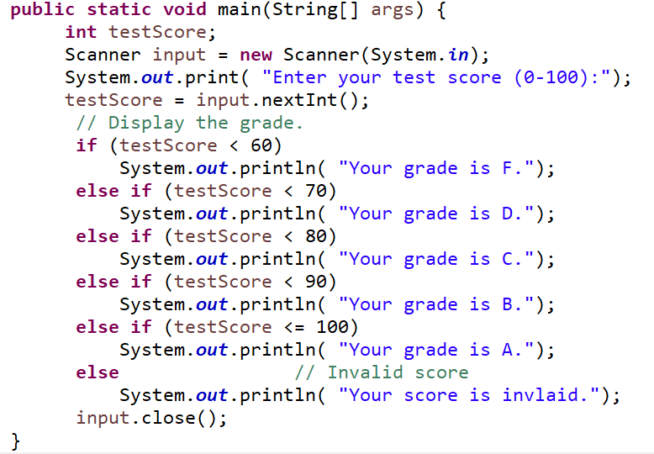

if…else if Statement

Slide 17
Logical Operators
Java provides two binary logical operators (&& and ||) that are used to combine boolean expressions.
Java also provides one unary (!) logical operator to reverse the truth of a boolean expression.
Logical OR
Logical AND
Expression 1 | Expression 2 | Expression1 || Expression2
true | false | true
false | true | true
false | false | false
true | true | true
Expression 1 | Expression 2 | Expression1 && Expression2
true | false | false
false | true | false
false | false | false
true | true | true
Expression 1 | !Expression1
true | false
false | true
Logical NOT

Slide 18
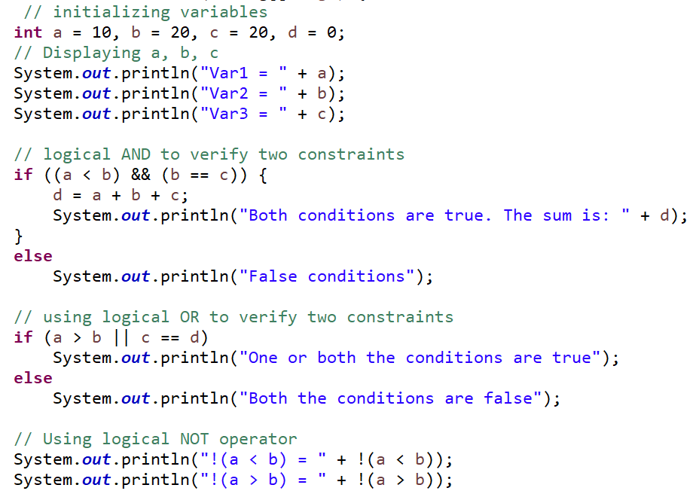
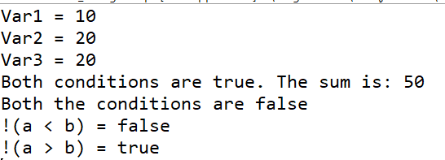
Logical Operators

Slide 19
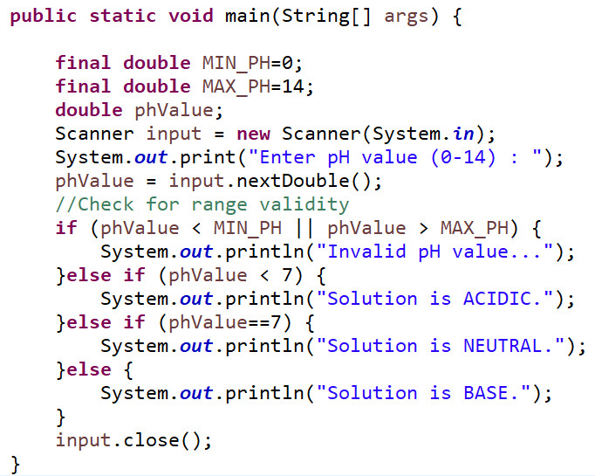


Range Check Using if Statement
If statement with relational operator can be used to check if a value is within a valid range.

Slide 20
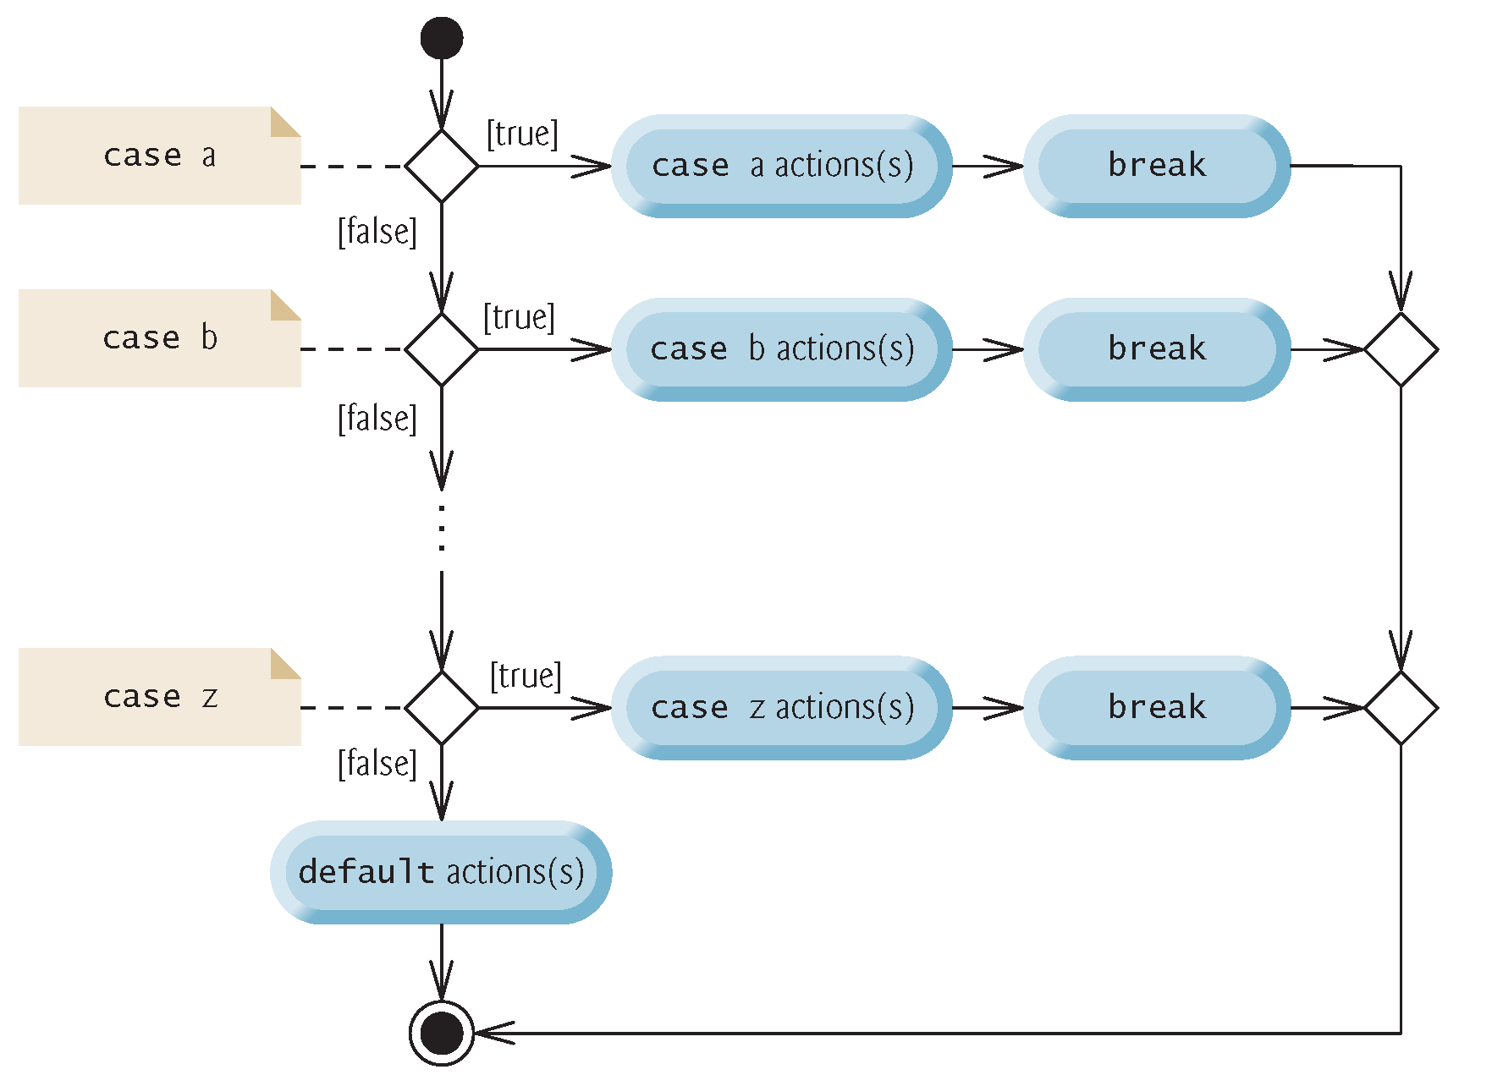
The switch Statement
The if-else statement allows you to make true / false branches.
The switch statement allows you to use an ordinal value to determine how a program will branch.
The switch statement can evaluate an integer type or character type variable and make decisions based on the value.
The break and default keywords are optional.

Slide 21
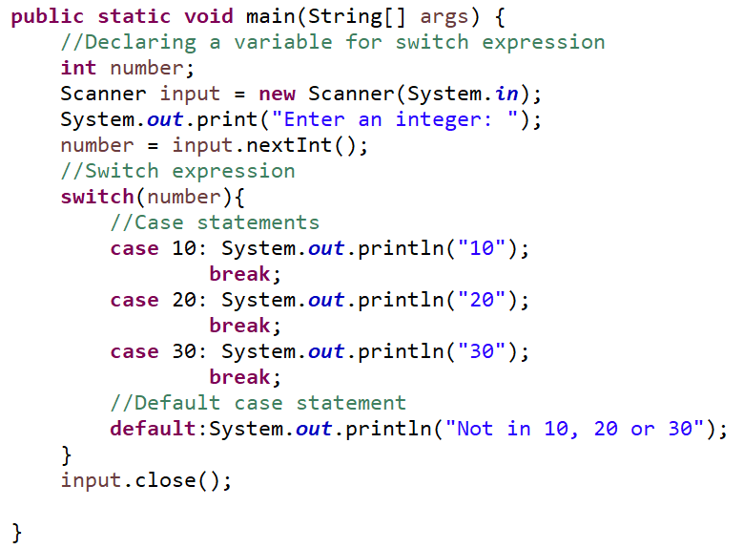


The switch Statement

Slide 22
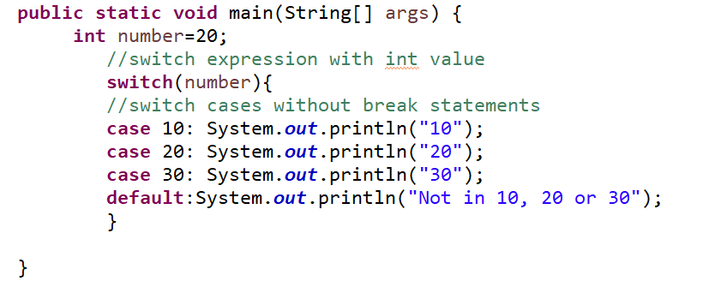

The switch Statement – Fall Through
The Java switch statement is fall-through. It means it executes all statements after the first match if a break statement is not present.

Slide 23
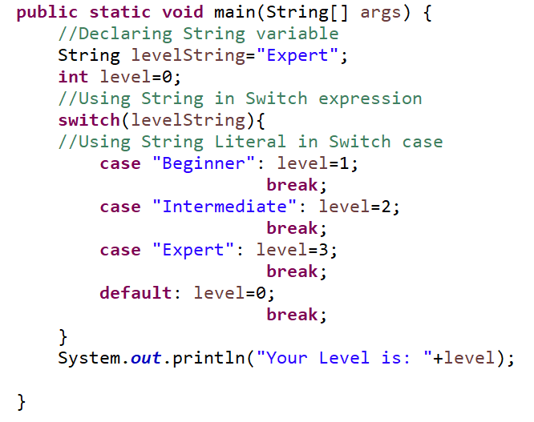
Java Switch Statement with String
Java allows us to use strings in switch expression since Java SE 7. The case statement should be string literal.

Slide 24
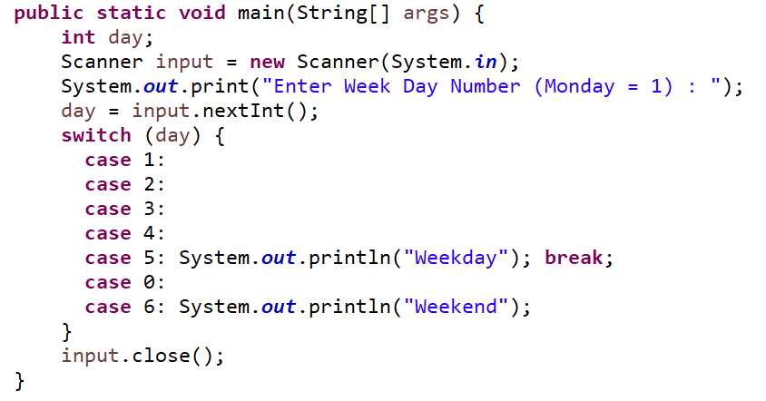



Java Switch Statement: Empty Case
Empty case means OR!
No output? Why?

